Slide 1
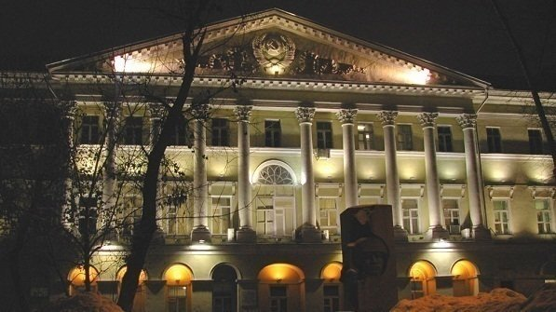
роль стандартов alte в обучении межкультурной коммуникации
Выступление в Высшей школе экономики 7 декабря 2018 г.
Радченко Олег Анатольевич, д.ф.н., проф. Профессор кафедры общего и сравнительного языкознания ФГБОУ ВО МГЛУ, научный руководитель Центра лингводидактики, языкового тестирования и содействия миграционной политике ФГБОУ ВО ГосИРЯ им. А.С. Пушкина

Slide 2
an association of language test providers who work together to promote the fair and accurate assessment of linguistic ability across Europe and beyond was founded in 1989 by the University of Cambridge (UK) and the Universidad de Salamanca (Spain) today counts with 32 Full Members, 58 Institutional Affiliates, and over 500 Individual Affiliates.

Slide 3
Kazan Federal University Russian Federation | Founded in 1804, Kazan Federal University is among the 10 best institutions of higher education in Russian Federation. The Institute of Philology and Intercultural Communication of Kazan Federal University is a major provider of undergraduate and post-graduate degree programmes in languages in the Volga Region of the country. Located in the capital of Tatarstan Republic, the Institute hosts the largest number of professors and scholars who teach and research the Tatar language, the mother tongue of the second largest ethnic group in Russia. According to the agreement with the Ministry of Education and Science of Tatarstan, the Institute has established the Tatar Language Certification Center, which currently develops tests for A1-C2 levels.
St. Petersburg State University (SPbSU) Russian Federation | Founded in 1724, St. Petersburg State University (SPbSU) is the oldest institution of higher education in Russia and has, over the 290 years of its existence, gained a reputation as one of the country’s best universities. The SPbSU Language Testing Center was established on August 22 1997 for the purpose of administering the Test of Russian as a Foreign Language (TORFL), a standardized test supervised by the Russian Ministry of Education and Science, and is authorized to issue a state certificate. This certificate is the only official document certifying levels of proficiency in Russian as a foreign language, and is required for admission to Russian universities and entry into citizenship of the Russian Federation.
Pushkin State Russian Language Institute Russian Federation | Established in 1966, the Institute is one of the leading institutions of higher education in Russia in the field of educating Russian language teachers. More than 150,000 students from Russia and from 126 other countries have successfully graduated from the Institute, and more than 400,000 students have completed their education at its international branches. In 2013, the Institute was granted the status of the key institution of the Commonwealth of Independent States in the area of Russian language teaching. The Institute has been developing tests for Russian and Russian as Foreign Language at all levels for different types of learners, including bilingual children. The Institute offers the Test of Russian as a Foreign Language (TORFL) as well as Pushkin Institute Certificate Tests for Russian.
he Herzen State Pedagogical University of Russia Russian Federation | Founded in 1797, The Herzen State Pedagogical University of Russia is one of the biggest and oldest establishments of higher education in St. Petersburg and in Russia. As the first pedagogical university in Russia, Herzen University nowadays remains the leading educational institution within the country. Herzen University is authorized to provide the Integration Exam and issue the certificate of knowledge for Russian as a foreign language, history of Russia and basics of Russian Legislation approved by the government of the Russian Federation. Another state exam Herzen University is eligible to provide is the Test of Russian as a Foreign Language (TORFL), a standardized test supervised by the Russian Ministry of Education and Science. The TORFL is a contemporary test of Russian language for foreign citizens certifying levels of proficiency in Russian as a foreign and is required for admission to Russian universities and entry into citizenship of the Russian Federation.
RUDN University Russian Federation | RUDN University (Peoples’ Friendship University of Russia) is one of the leading universities of Russia. Created in 1960, it is a classical university; one of its priorities is to develop linguistics and the scientific school of teaching Russian as a foreign language. RUDN University provides Russian Language classes (all levels) for students from 150 countries. The University makes scientific research in the fields of linguodidactics and language testing; RUDN teachers are part of the TORFL team. In 2014 the university became the main author of the new integration 3-module state exam (the Russian language, the history of Russia, Russian Federation Law basics) promoting social integration of migrants. There are three examination centers at the University developing examinations and testing materials. A special Faculty of refresher training for teachers of Russian as a foreign language provides teachers and examiners’ training courses in Russia and all over the world.

Slide 4
a non-for-profit, International Non-Governmental Organisation (INGO), gained Participatory Status with the Council of Europe in 2003. ALTE's ground-breaking work to set common levels of language proficiency across different languages contributed significantly to the later development of the Council of Europe's Common European Framework of Reference (CEFR). ALTE Members and Institutional Affiliates meet three times per year in different locations around Europe, where they discuss language testing issues and help disseminate best practices in language assessment. latest Meeting: Salamanca, Spain, November 2018

Slide 5
Kom- petenz- Niveau | Kompetenz- Beschreibung | Niveau- Stufe | Beschreibung des Referenz- Niveaus | Kann-Beschreibungen (Beschreibung der erforderlichen Fähigkeiten)
A | Basic User Elementare Sprachverwendung | A1 | Breakthrough oder Beginner (Einstieg) | Kann vertraute, alltägliche Ausdrücke und ganz einfache Sätze verstehen und verwenden, die auf die Befriedigung konkreter Bedürfnisse zielen. Kann sich und andere vorstellen und anderen Leuten Fragen zu ihrer Person stellen – z. B. wo sie wohnen, welche Leute sie kennen oder welche Dinge sie haben – und kann auf Fragen dieser Art Antwort geben. Kann sich auf einfache Art verständigen, wenn die Gesprächspartnerinnen oder Gesprächspartner langsam und deutlich sprechen und bereit sind zu helfen.
 |  | A2 | Waystage oderElementary (Grundlagen) | Kann Sätze und häufig gebrauchte Ausdrücke verstehen, die mit Bereichen von ganz unmittelbarer Bedeutung zusammenhängen (z. B. Informationen zur Person und zur Familie, Einkaufen, Arbeit, nähere Umgebung). Kann sich in einfachen, routinemäßigen Situationen verständigen, in denen es um einen einfachen und direkten Austausch von Informationen über vertraute und geläufige Dinge geht. Kann mit einfachen Mitteln die eigene Herkunft und Ausbildung, die direkte Umgebung und Dinge im Zusammenhang mit unmittelbaren Bedürfnissen beschreiben.
B | Independent User Selbstständige Sprachverwendung | B1 | Threshold oderIntermediate (Mittelstufe) | Kann die Hauptpunkte verstehen, wenn klare Standardsprache verwendet wird und wenn es um vertraute Dinge aus Arbeit, Schule, Freizeit usw. geht. Kann die meisten Situationen bewältigen, denen man auf Reisen im Sprachgebiet begegnet. Kann sich einfach und zusammenhängend über vertraute Themen und persönliche Interessengebiete äußern. Kann über Erfahrungen und Ereignisse berichten, Träume, Hoffnungen und Ziele beschreiben und zu Plänen und Ansichten kurze Begründungen oder Erklärungen geben.
 |  | B2 | Vantage oder Upper intermediate (gute Mittelstufe) | Kann die Hauptinhalte komplexer Texte zu konkreten und abstrakten Themen verstehen; versteht im eigenen Spezialgebiet auch Fachdiskussionen. Kann sich so spontan und fließend verständigen, dass ein normales Gespräch mit Muttersprachlern ohne größere Anstrengung auf beiden Seiten gut möglich ist. Kann sich zu einem breiten Themenspektrum klar und detailliert ausdrücken, einen Standpunkt zu einer aktuellen Frage erläutern und die Vor- und Nachteile verschiedener Möglichkeiten angeben.
C | Proficient User Kompetente Sprachverwendung | C1 | Effective Operational Proficiency oder Advanced (fortgeschrittene Kenntnisse) | Kann ein breites Spektrum anspruchsvoller, längerer Texte verstehen und auch implizite Bedeutungen erfassen. Kann sich spontan und fließend ausdrücken, ohne öfter deutlich erkennbar nach Worten suchen zu müssen. Kann die Sprache im gesellschaftlichen und beruflichen Leben oder in Ausbildung und Studium wirksam und flexibel gebrauchen. Kann sich klar, strukturiert und ausführlich zu komplexen Sachverhalten äußern und dabei verschiedene Mittel zur Textverknüpfung angemessen verwenden.
 |  | C2 | Mastery oderProficiency (exzellente Kenntnisse) | Kann praktisch alles, was er/sie liest oder hört, mühelos verstehen. Kann Informationen aus verschiedenen schriftlichen und mündlichen Quellen zusammenfassen und dabei Begründungen und Erklärungen in einer zusammenhängenden Darstellung wiedergeben. Kann sich spontan, sehr flüssig und genau ausdrücken und auch bei komplexeren Sachverhalten feinere Bedeutungsnuancen deutlich machen.

Slide 6
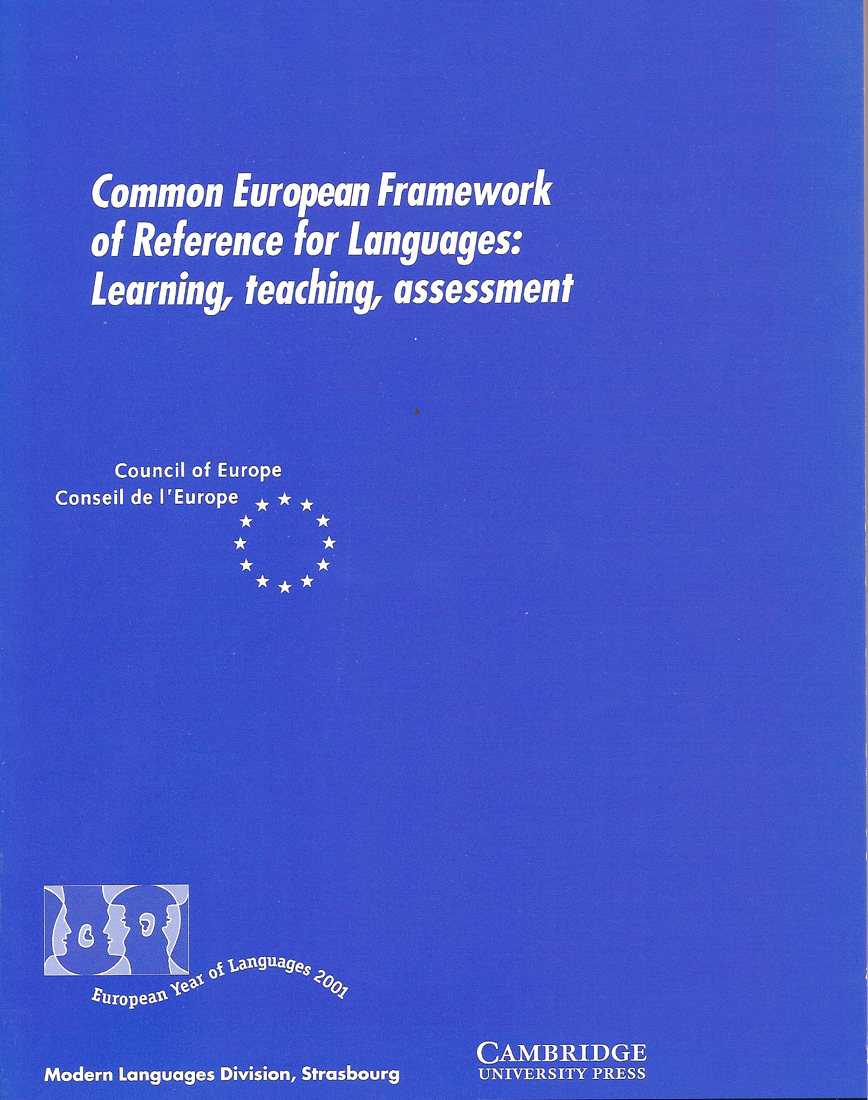
1.3 What is ‘plurilingualism’? - In recent years, the concept of plurilingualism has grown in importance in the Council of Europe’s approach to language learning. - Plurilingualism differs from multilingualism, which is the knowledge of a number of languages, or the co-existence of different languages in a given society. - Multilingualism may be attained by simply diversifying the languages on offer in a particular school or educational system, or by encouraging pupils to learn more than one foreign language, or reducing the dominant Position of English in international communication. - Beyond this, the plurilingual approach emphasises the fact that as an individual person’s experience of language in its cultural contexts expands, from the language of the home to that of society at large and then to the languages of other peoples (whether learnt at school or college, or by direct experience), he or she does not keep these languages and cultures in strictly separated mental compartments, but rather builds up a communicative competence to which all knowledge and experience of language contributes and in which languages interrelate and interact.

Slide 7
In different situations, a person can call flexibly upon different parts of this competence to achieve effective communication with a particular interlocutor. For instance, partners may switch from one language or dialect to another, exploiting the ability of each to express themselves in one language and to understand the other; or a person may call upon the knowledge of a number of languages to make sense of a text, written or even spoken, in a previously ‘unknown’ language, recognising words from a common international store in a new guise. Those with some knowledge, even slight, may use it to help those with none to communicate by mediating between individuals with no common language. In the absence of a mediator, such individuals may nevertheless achieve some degree of communication by bringing the whole of their linguistic equipment into play, experimenting with alternative forms of expression in different languages or dialects, exploiting paralinguistics (mime, gesture, facial expression, etc.) and radically simplifying their use of language. From this perspective, the aim of language education is profoundly modified. It is no longer seen as simply to achieve ‘mastery’ of one or two, or even three languages, each taken in isolation, with the ‘ideal native speaker’ as the ultimate model. Instead, the aim is to develop a linguistic repertory, in which all linguistic abilities have a place. This implies, of course, that the languages offered in educational institutions should be diversified and students given the opportunity to develop a plurilingual competence. Furthermore, once it is recognised that language learning is a lifelong task, the development of a young person’s motivation, skill and confidence in facing new language experience out of school comes to be of central importance. The responsibilities of educational authorities, qualifying examining bodies and teachers cannot simply be confined to the attainment of a given level of proficiency in a particular language at a particular moment in time, important though that undoubtedly is.

Slide 8
The full implications of such a paradigm shift have yet to be worked out and translated into action. The recent developments in the Council of Europe’s language programme have been designed to produce tools for use by all members of the language teaching profession in the promotion of plurilingualism. In particular, The European Language Portfolio (ELP) provides a format in which language learning and intercultural experiences of the most diverse kinds can be recorded and formally recognised. For this purpose, CEF not only provides a scaling of overall language proficiency in a given language, but also a breakdown of language use and language competences which will make it easier for practitioners to specify objectives and describe achievements of the most diverse kinds in accordance with the varying needs, characteristics and Resources of learners.

Slide 9
COMMON EUROPEAN FRAMEWORK OF REFERENCE FOR LANGUAGES: LEARNING, TEACHING, ASSESSMENT COMPANION VOLUME WITH NEW DESCRIPTORS
Language Policy Programme Education Policy Division Education Department Council of Europe
Institutes (organised in alphabetical order by country) that participated between February and November 2015 in the validation of the descriptors for mediation, online interaction, reactions to literature and plurilingual/pluricultural competence, and/or assisted in initial piloting. The Council of Europe also wishes to thank the many individual participants, all of whose institutes could not be included.
Russia
Globus International Language Centres National Research University Higher Schools of Economics,
Moscow Lomonosov State University Nizhny Novgorod Linguistics University
Samara State University
Moscow State Institute of International Relations
St Petersburg State University

Slide 10
ONLINE CONVERSATION AND DISCUSSION
C2
Can express him/herself with clarity and precision in real-time online discussion, adjusting language flexibly and sensitively
to context, including emotional, allusive and joking usage.
Can anticipate and deal effectively with possible misunderstandings (including cultural ones), communication issues and
emotional reactions occurring in an online discussion.
Can easily and quickly adapt his/her register and style to suit different online environments, communication purposes and
speech acts.
…………………………..
A2 media by expressing feelings of surprise, interest and indifference in a simple way.
Can engage in basic social communication online (e.g. writing a simple message on a virtual card for a special occasion,
sharing news and making/confirming arrangements to meet).
Can make brief positive or negative comments online about embedded links and media using a repertoire of basic
language, though he/she will generally have to refer to an online translation tool and other resources.
A1
Can write very simple messages and personal online postings as a series of very short sentences about hobbies,
likes/dislikes, etc., relying on the aid of a translation tool.
Can use formulaic expressions and combinations of simple words to post short positive and negative reactions to simple
online postings and their embedded links and media, and can respond to further comments with standard expressions of
thanks and apology.
Pre-A1
Can post simple online greetings, using basic formulaic expressions and emoticons.
Can post online short simple statements about him/herself (e.g. relationship status, nationality, occupation), provided
he/she can select them from a menu and/or refer to an online translation tool.

Slide 11
Plurilingual competence as explained in the CEFR (Section 1.3) involves the ability to call flexibly upon an inter-related, uneven, plurilinguistic repertoire to: ► switch from one language or dialect (or variety) to another; ► express oneself in one language (or dialect, or variety) and understand a person speaking another; ► call upon the knowledge of a number of languages (or dialects, or varieties) to make sense of a text; ► recognise words from a common international store in a new guise; ► mediate between individuals with no common language (or dialect, or variety), even with only a slight knowledge oneself; ► bring the whole of one’s linguistic equipment into play, experimenting with alternative forms of expression; ► exploit paralinguistics (mime, gesture, facial expression, etc.). Mediation between individuals with no common language is one of the activities in the list above. Because of the plurilingual nature of such mediation, descriptors were also developed and validated for the other points in the above list during the 2014–17 Project to develop descriptors for mediation. This was successful except in respect of the last point (paralinguistics), on which unfortunately informants could not agree as to its relevance or interpret descriptors consistently.

Slide 12
Table 1 – Macro-functional basis of CEFR categories for communicative language activities RECEPTION PRODUCTION INTERACTION MEDIATION Creative, e.g. Reading e.g. Sustained e.g. Conversation Mediating Interpersonal as a leisure monologue: communication Language Use activity Describing experience Transactional e.g. Reading e.g. Sustained e.g. Obtaining goods Mediating a text Language for information monologue: and services Information Use and argument Giving information exchange Evaluative, (Merged with e.g. Sustained monologue e.g. Discussion Mediating concepts Problem-solving reading for : Presenting a case Language Use information and argument
The CEFR introduces the concept of mediation as follows: ‘In both the receptive and productive modes, the written and/or oral activities of mediation make communication possible between persons who are unable, for whatever reason to communicate with each other directly. Translation or interpretation, a paraphrase, summary or record, provides for a third party a (re)formulation of a source text to which this third party does not have direct access. Mediation language activities, (re)processing an existing text, occupy an important place in the normal linguistic functioning of our societies.’(CEFR Section 2.1.3)

Slide 13
Communicative language strategies in the CEFR: MEDIATION - Linking to previous knowledge - Adapting language - Breaking down complicated info - Amplifying a dense text - Streamlining a text

Slide 14
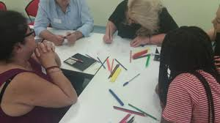
The approach taken to mediation in the project to extend the CEFR illustrative descriptors is thus wider than considering only cross-linguistic mediation. In addition to cross-linguistic mediation, it also encompasses mediation related to communication and learning as well as social and cultural mediation. This wider approach has been taken because of its relevance in increasingly diverse classrooms, in relation to the spread of CLIL, (Content and Language Integrated Learning), and because mediation is increasingly seen as a part of all learning, but especially of all language learning. The mediation descriptors are particularly relevant for the classroom in connection with small group, collaborative tasks. The tasks can be organized in such a way that learners have to share different input, explaining their information and working together in order to achieve a goal. They are even more relevant when this is undertaken in a CLIL context.

Slide 15
A 2-2 Can play a supportive role in interaction, provided that other participants speak slowly and that one or more of them helps him/her to contribute and to express his/her suggestions. Can convey relevant information contained in clearly structured, short, simple, informational texts, provided that the texts concern concrete, familiar subjects and are formulated in simple everyday language. A2-1 Can use simple words to ask someone to explain something. Can recognise when difficulties occur and indicate in simple language the apparent nature of a problem. Can convey the main point(s) involved in short, simple conversations or texts on everyday subjects of immediate interest provided these are expressed clearly in simple language.
C 2
Can mediate effectively and naturally, taking on different roles according to the needs of the people and situation involved, identifying nuances and undercurrents and guiding a sensitive or delicate discussion. Can explain in clear, fluent, wellstructured language the way facts and arguments are presented, conveying evaluative aspects and most nuances precisely, and pointing out sociocultural implications (e.g. use of register, understatement, irony and sarcasm).
A1 Can use simple words and non-verbal signals to show interest in an idea. Can convey simple, predictable information of immediate interest given in short, simple signs and notices, posters and programmes.

Slide 16
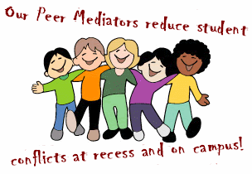
The scales for mediation are presented in three groups, reflecting the way in which mediation tends to occur. Mediating a text ► Relaying specific information – in speech and in writing ► Explaining data (e.g. in graphs, diagrams, charts etc.) – in speech and in writing ► Processing text – in speech and in writing ► Translating a written text – in speech and in writing ► Note-taking (lectures, seminars, meetings, etc.) ► Expressing a personal response to creative texts (including literature) ► Analysis and criticism of creative texts (including literature) Mediating concepts ► Collaborating in a group ► Facilitating collaborative interaction with peers ► Collaborating to construct meaning ► Leading group work ► Managing interaction ► Encouraging conceptual talk Mediating communication ► Facilitating pluricultural space ► Acting as intermediary in informal situations (with friends and colleagues) ► Facilitating communication in delicate situations and disagreements

Slide 17
In mediation, the user/learner acts as a social agent who creates bridges and helps to construct or convey meaning, sometimes within the same language, sometimes from one language to another (cross-linguistic mediation). The focus is on the role of language in processes like creating the space and conditions for communicating and/or learning, collaborating to construct new meaning, encouraging others to construct or understand new meaning, and passing on new information in an appropriate form. The context can be social, pedagogic, cultural, linguistic or professional.

Slide 18
Mediation activities There are many different aspects of mediation, but all share certain characteristics. For example, in mediation, one is less concerned with one’s own needs, ideas or expression, than with those of the party or parties for whom one is mediating. A person who engages in mediation activity needs to have a well-developed emotional intelligence, or an openness to develop it, in order to have sufficient empathy for the viewpoints and emotional states of other participants in the communicative situation. The term mediation is also used to describe a social and cultural process of creating conditions for communication and cooperation, facing and hopefully defusing any delicate situations and tensions that may arise. Particularly with regard to cross-linguistic mediation, users should remember that this inevitably also involves social and cultural competence as well as plurilingual competence. This underlines the fact that one cannot in practice completely separate types of mediation from each other. In adapting descriptors to their context, therefore, users should feel free to mix and match categories to suit their own perspective. The scales for mediation are presented in three groups, reflecting the way in which mediation tends to occur.

Slide 19
Mediating a text ► Relaying specific information – in speech and in writing ► Explaining data (e.g. in graphs, diagrams, charts etc.) – in speech and in writing ► Processing text – in speech and in writing ► Translating a written text – in speech and in writing ► Note-taking (lectures, seminars, meetings, etc.) ► Expressing a personal response to creative texts (including literature) ► Analysis and criticism of creative texts (including literature)

Slide 20
Mediating concepts ► Collaborating in a group ► Facilitating collaborative interaction with peers ► Collaborating to construct meaning ► Leading group work ► Managing interaction ► Encouraging conceptual talk

Slide 21
Mediating communication ► Facilitating pluricultural space ► Acting as intermediary in informal situations (with friends and colleagues) ► Facilitating communication in delicate situations and disagreements

Slide 22
Facilitating pluricultural space This scale reflects the notion of creating a shared space between and among linguistically and culturally different interlocutors, i.e. the capacity of dealing with ‘otherness’ to identify similarities and differences to build on known and unknown cultural features, etc. in order to enable communication and collaboration. The user/learner aims to facilitate a positive interactive environment for successful communication between participants of different cultural backgrounds, including in multicultural contexts. Rather than simply building on his/her pluricultural repertoire to gain acceptance and to enhance his own mission or message (see Building on pluricultural repertoire), he/she is engaged as a cultural mediator: creating a neutral, trusted, shared ‘space’ in order to enhance the communication between others. He/she aims to expand and deepen intercultural understanding between participants in order to avoid and/or overcome any potential communication difficulties arising from contrasting cultural viewpoints. Naturally, the mediator him/herself needs a continually developing awareness of sociocultural and sociolinguistic differences affecting crosscultural communication. Key concepts operationalised in the scale include the following: ► using questions and showing interest to promote understanding of cultural norms and perspectives between speakers; ► demonstrating sensitivity to and respect for different sociocultural and sociolinguistic perspectives and norms; ► anticipating, dealing with and/or repairing misunderstandings arising from sociocultural and sociolinguistic differences. Progression up the scale is characterised as follows: At B1 the emphasis is on introducing people and showing interest and empathy by asking and answering questions. By B2+, appreciation of different perspectives and flexibility are central: the ability to belong to a group yet maintain balance and distance, express oneself sensitively, clarify misunderstandings and explain how things were meant. This aspect is developed further in the C levels, where the user/learner can control his/her actions and expression according to context, making subtle adjustments in order to prevent and/or repair misunderstandings and cultural incidents. By C2, he/she can mediate effectively and naturally, taking account of sociocultural and sociolinguistic differences.

Slide 23
FACILITATING PLURICULTURAL SPACE
C2
Can mediate effectively and naturally between members of his/her own and other communities, taking account of
sociocultural and sociolinguistic differences.
Can guide a sensitive discussion effectively, identifying nuances and undercurrents.
C1
Can act as mediator in intercultural encounters, contributing to a shared communication culture by managing ambiguity
offering advice and support, and heading off misunderstandings.
Can anticipate how people might misunderstand what has been said or written and help to maintain positive interaction by
commenting on and interpreting different cultural perspectives on the issue concerned.
Can exploit knowledge of socio-cultural conventions in order to establish a consensus on how to proceed in a particular
situation unfamiliar to everyone involved.
Can, in intercultural encounters, demonstrate appreciation of perspectives other than his/her own normal worldview, and
express him/herself in a way appropriate to the context.
Can clarify misunderstandings and misinterpretations during intercultural encounters, suggesting how things were actually
B2 meant in order to clear the air and move the discussion forward.
Can encourage a shared communication culture by expressing understanding and appreciation of different ideas, feelings
and viewpoints, and inviting participants to contribute and react to each other’s ideas.
Can work collaboratively with people who have different cultural orientations, discussing similarities and differences in
views and perspectives.
Can, when collaborating with people from other cultures, adapt the way he/she works in order to create shared procedures.
Can support communication across cultures by initiating conversation, showing interest and empathy by asking and
answering simple questions, and expressing agreement and understanding.
Can act in a supportive manner in intercultural encounters, recognising the feelings and different world views of other
members of the group.
B1 Can support an intercultural exchange using a limited repertoire to introduce people from different cultural backgrounds and
to ask and answer questions, showing awareness that some questions may be perceived differently in the cultures
concerned.
Can help to develop a shared communication culture, by exchanging information in a simple way about values and
attitudes to language and culture.
A2 Can contribute to an intercultural exchange, using simple words to ask people to explain things and to get clarification of
what they say, whilst exploiting his/her limited repertoire to express agreement, to invite, to thank etc.
A1 Can facilitate an intercultural exchange by showing welcome and interest with simple words and non-verbal signals, by
inviting others to speak and by indicating whether he/she understands when addressed directly.
Pre-A1 No descriptors available

Slide 24
