Slide 1
Master’s Program “Foreign Languages and Intercultural Communication”
School of Foreign Languages
Moscow 2022

Slide 2
Outline
School of Foreign Languages
Master’s Program “Foreign Languages and Intercultural Communication
Program overview
Courses and specializations
Specialization “Intercultural Communication in a Global Information Space”

Slide 3
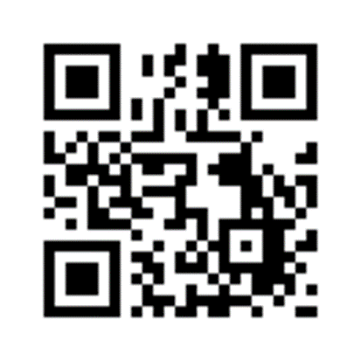
Program overview
School of Foreign Languages
Master’s Program “Foreign Languages and Intercultural Communication
45.04.02 – Linguistics
4 specializations:
Foreign Language Teaching
Intercultural Communication in a Global Information Space
Modern Translation and Interpreting Studies
Linguistic Research in a Modern Interdisciplinary Context
https://www.hse.ru/ma/lc

Slide 4
School of Foreign Languages
Master’s Program “Foreign Languages and Intercultural Communication”
FLAIC
Key seminars
Internship
Final State Certification
Mago-Lego
Major

Slide 5
School of Foreign Languages
Master’s Program “Foreign Languages and Intercultural Communication”
Key seminars
Adviser’s seminar
Research and project Seminars

Slide 6
School of Foreign Languages
Master’s Program “Foreign Languages and Intercultural Communication”
Research and project seminars
Year 1:
focus on linguistics
Year 2:
focus on specializations

Slide 7
School of Foreign Languages
Master’s Program “Foreign Languages and Intercultural Communication”
Research and project seminars
Year 1 | Year 2
Language for Specific Purposes Phonetic Variation in Multicultural Communication in English Axiological Linguistics Language Policy in the Context of Ethnocultural Diversity Germanic and Romance Languages Linguistic Personology | Translation and Interpreting in Professional Communication
 | Translinguistics and Transcultural Communication
 | Foreign Language Teacher's Continuous Professional Development
 | New Trends and Methods in Modern Areas of Linguistics

Slide 8
Mago-Lego: choose whatever you like!
School of Foreign Languages
Master’s Program “Foreign Languages and Intercultural Communication
https://lap.hse.ru/news/227172470.html

Slide 9
Internship
School of Foreign Languages
Master’s Program “Foreign Languages and Intercultural Communication”
Research
at HSE University or outside
For specialization “Linguistic Research in a Modern Interdisciplinary Context
Professional
at HSE University or outside
For all other specializations
Project
Project Fair
Whatever you like

Slide 10
School of Foreign Languages
Master’s Program “Foreign Languages and Intercultural Communication”
Major
For all
For specializations

Slide 11
Major for all: core requirements
School of Foreign Languages
Master’s Program “Foreign Languages and Intercultural Communication
English for the Current Social Agenda
General Linguistics and History of Linguistic Studies
Text: Creating, Interpreting, and Editing
Second foreign language (choose one):
German
French
Spanish
Italian

Slide 12
Major for all: electives
School of Foreign Languages
Master’s Program “Foreign Languages and Intercultural Communication
Russia and Britain: Allies or Enemies? (the Changing Relations of the World’s Great Powers in the 20th and 21st Centuries)
English Literature of 20 and 21 Centuries
Laughter and Carnival as Symptoms of the Coen Brothers Films
English-Speaking Countries after World War II
Contemporary Culture of German, Spanish, Italian and French Speaking Countries

Slide 13
School of Foreign Languages
Mater’s Program “Foreign Languages and Intercultural Communication”
Major for specializations: core requirements
Specializations | Courses
Foreign Language Teaching | Foreign Language Teaching to Younger and Adult Learners in Different Contexts
Intercultural Communication in a Global Information Space | Pragmatics of Inter- and Cross-Cultural Communication
Modern Translation and Interpreting Studies | Translation and Interpreting: Theory and Practice
Linguistic Research in a Modern Interdisciplinary Context | Recent Advances in Linguistic Theory

Slide 14
School of Foreign Languages
Mater’s Program “Foreign Languages and Intercultural Communication”
Major for specializations: electives
Specializations | Courses
Foreign Language Teaching | ICT in Teaching Foreign Languages Foreign Language Assessment
Intercultural Communication in a Global Information Space | Modelling of Intercultural Dialogue Intercultural Mediation
Modern Translation and Interpreting Studies | Translation of Business Documentation Scientific and Technical Translation
Linguistic Research in a Modern Interdisciplinary Context | Linguistic Creativity Diversity of Metaphor Landscapes (?)

Slide 15
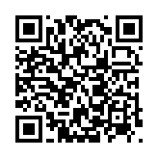
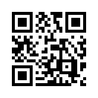
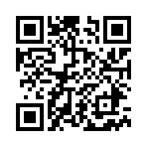
How to apply
School of Foreign Languages
Master’s Program “Foreign Languages and Intercultural Communication”
Portfolio:
2. Vysshaya Liga Contest:
3. Ya – Professional Contest:
https://ma.hse.ru/mirror/pubs/share/544276272.pdf
https://olymp.hse.ru/ma/
https://yandex.ru/profi/index

Slide 16
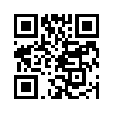
How to apply: important facts
School of Foreign Languages
Master’s Program “Foreign Languages and Intercultural Communication”
state-funded – 25 students
tuition fee – 10+ students
state-funded international – 10 students
tuition fee international – 6+ students
tuition fee – 430,000 RUB
discounts
application submission: 20 June – 26 July
interviews: mid-July – early August
Central Admissions Office: https://ma.hse.ru/

Slide 17
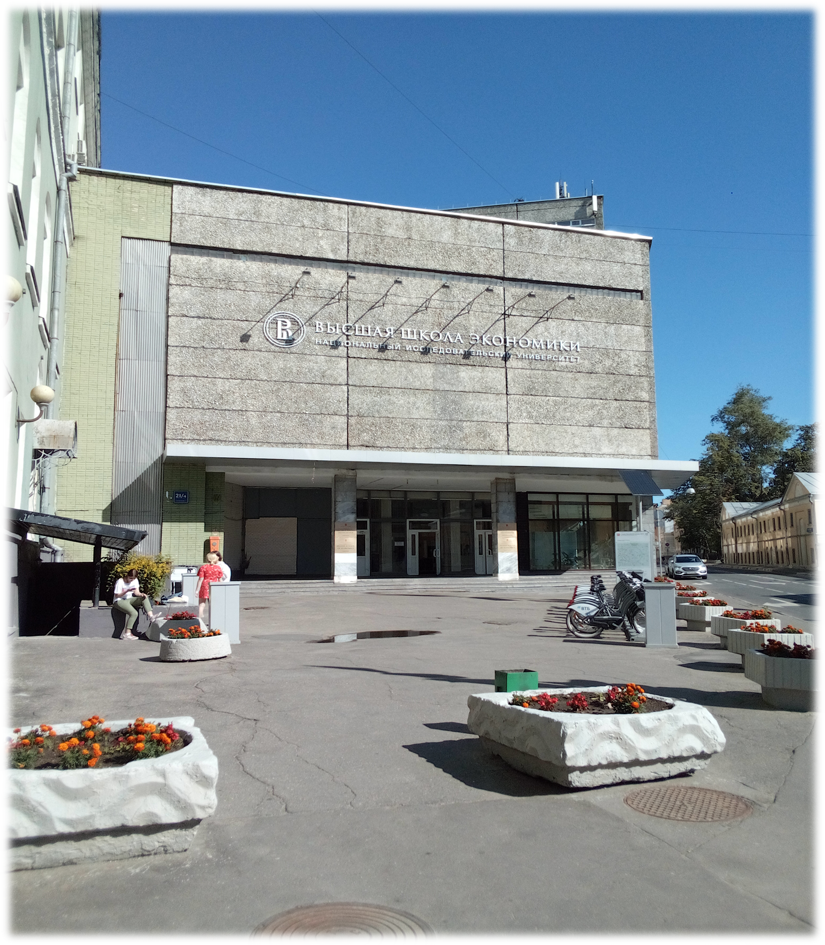
Contact info
School of Foreign Languages
Master’s Program “Foreign Languages and Intercultural Communication”
Website: https://www.hse.ru/ma/lc/
Address: 21/4 Staraya Basmannaya Street, Hall V, Office V202v (В202в)
Tel.: +7(495)772-95-90, ext.:
*23727 (A.V. Bakulev; abakulev@hse.ru)
*22881 (I.I. Zhunich; izhunich@hse.ru)
https://vk.com/langhse
https://vk.com/hse_ma_lc
https://www.facebook.com/hse.ma.lc

